Slide 1
Content
Enlightening the I/O Path: A Holistic Approach for Application Performance (FAST'17)
FastTrack: Foreground App-Aware I/O Management for Improving User Experience of Android Smartphones (ATC'18)
Unblinding the OS to Optimize User-Perceived Flash SSD Latency (HotStorage'2016)

Slide 2
Content
Enlightening the I/O Path: A Holistic Approach for Application Performance (FAST'17)
FastTrack: Foreground App-Aware I/O Management for Improving User Experience of Android Smartphones (ATC'18)
Unblinding the OS to Optimize User-Perceived Flash SSD Latency (HotStorage'2016)

Slide 3
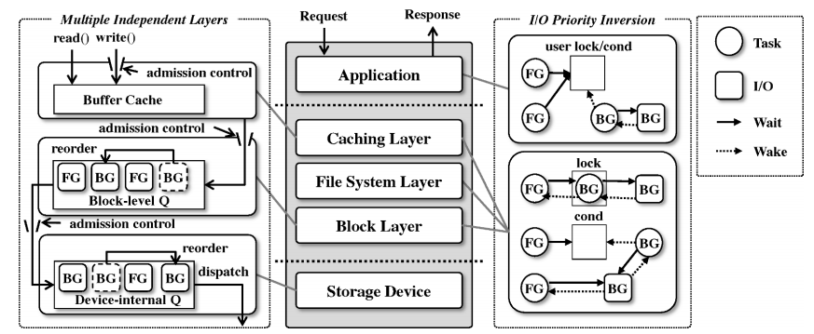
modern storage stacks

Slide 4
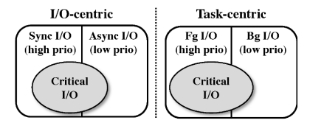
RCP:request-centric I/O prioritization
Classification:define a critical I/O as an I/O in the critical path of request handling

Slide 5
identify critical I/Os
track a set of tasks (i.e., foreground tasks) involved in request handling → application-guided approach
provide an enlightenment interface to user-level so that an application developer (or an administrator if possible) can dynamically set/clear a foreground task based on application-level semantics

Slide 6
identify critical I/Os
handle I/O priority inversions caused by runtime dependencies
introduce I/O priority inheritance that temporarily gives critical I/O priority to a background task or a background I/O on which a foreground task depends to make progress.

Slide 7
RCP:request-centric I/O prioritization
Criticality-Aware I/O Prioritization
caching layer:apply separate dirty ratios to tasks issuing critical and non-critical writes (low)
block layer:separately allocate the block queue slots for critical and non-critical I/Os
a simple priority-based I/O scheduler
device-level:limit the number of non-critical I/Os dispatched to a storage device

Slide 8
Content
Enlightening the I/O Path: A Holistic Approach for Application Performance (FAST'17)
FastTrack: Foreground App-Aware I/O Management for Improving User Experience of Android Smartphones (ATC'18)
Unblinding the OS to Optimize User-Perceived Flash SSD Latency (HotStorage'2016)

Slide 9
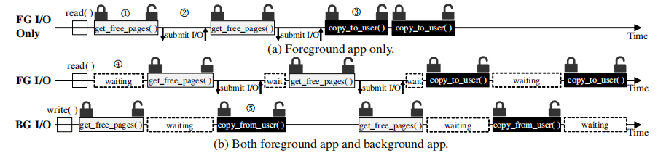
lock contention

Slide 10
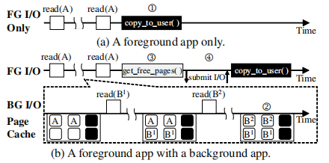
page replacement

Slide 11
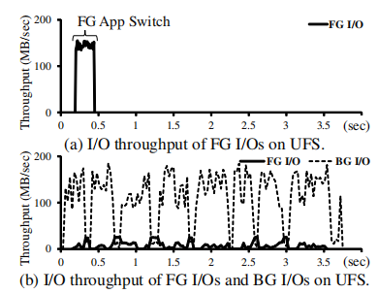
Device I/O Scheduling
the I/O priority inversion problem occurred in the storage device
priority-unaware I/O scheduler

Slide 12
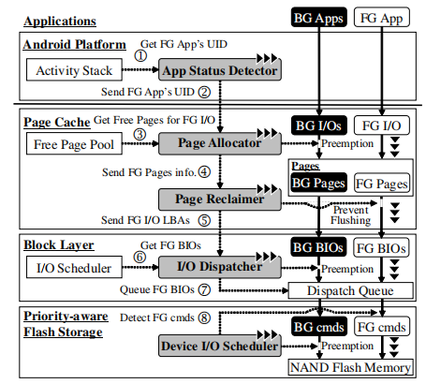
FastTrack

Slide 13
Content
Enlightening the I/O Path: A Holistic Approach for Application Performance (FAST'17)
FastTrack: Foreground App-Aware I/O Management for Improving User Experience of Android Smartphones (ATC'18)
Unblinding the OS to Optimize User-Perceived Flash SSD Latency (HotStorage'2016)

Slide 14
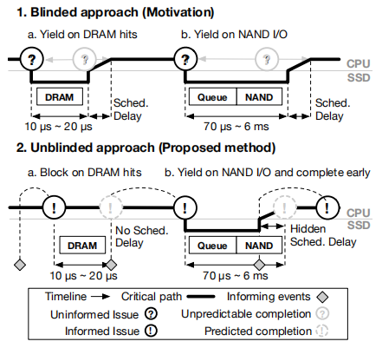
scheduling delays

